Slide 1
An Introduction to Agile
By : Abhishek Jain

Slide 2
Objective
After this session, you should be able to
Understand the concepts of Agile & its flavours
Have good insights about Scrum, Kanban and Scrumban
Should be able to implement Agile (or its flavour) in your project(s) or do it as per the best practices

Slide 3
Classical Waterfall Development
Requirements
Classical approach to software development
Design
Development
Testing
Maintenance

Slide 4
Challenges in Waterfall Development
Changes
Requirements
Design
Development
Skipped
Takes too long
Testing
Maintenance

Slide 5
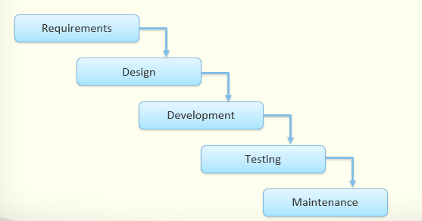
Unclear/Fuzzy Requirements
User Involvement only at the beginning and end
Cannot accommodate changes quickly
Testing very late in the project
Working Software visible very late
Heavy Documentation

Slide 6
What is Agile
Agile is not a process,
it’s a philosophy or set of values
Rapid
Adaptable
AGILE
Quality-driven
Cooperative
Iterative

Slide 7
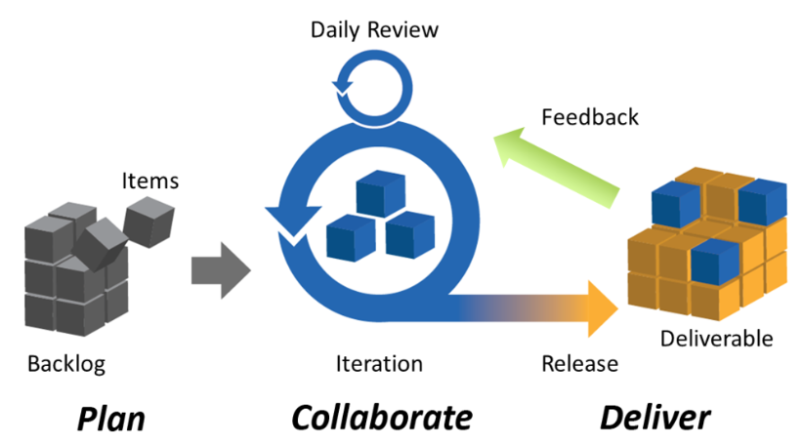
Agile Delivery Model
Agile is not a process,
it’s a philosophy or set of values
Rapid
Adaptable
AGILE
Quality-driven
Cooperative
Iterative

Slide 8
Agile Delivery Model
Iterative Development
Respond to changes
Continuous Integration
Ensures Transparency
Delivers Workable Software
Delivers Value

Slide 9
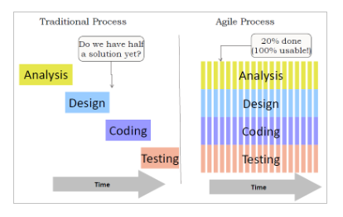
Agile Delivery Model

Slide 10
The Agile Manifesto
Individuals and interactions
over
Process and tools
Working Software
over
Comprehensive Documents
Customer Collaboration
over
Contract Negotiation
Responding to Change
over
Following a Plan

Slide 11
Agile Principles ..
Satisfying customer is top priority
Welcome changing requirements, even late in development
Deliver working software frequently, from a couple of weeks to a couple of months
Development teams and business work together
Build projects around motivated people
The most efficient and effective method of conveying information to and within a development team is face-to-face conversation

Slide 12
.. Agile Principles
The primary measure of success is working software
Agile processes promote sustainable development –The sponsors, developers and users should be able to maintain a constant pace in definitively.
Continuous attention to technical excellence and good design
Simplicity–the art of maximizing the amount of work done—is essential
The best architectures, requirements and designs emerge from self-organizing teams
The Team regularly reflects on work

Slide 13

Agile Umbrella
More Prescriptive
more rules to follow
Agile
- Rational Unified Process
- XP
FDD
- Scrum
Scrum
RUP
- Kanban
Kanban
XP
- Do Whatever!!
More Adaptive
fewer rules to follow

Slide 14
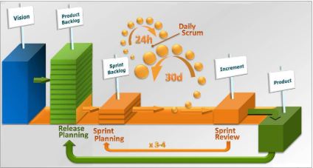
Scrum at a Glance

Slide 15
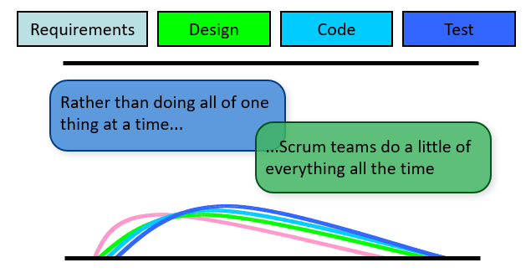
Scrum at a Glance

Slide 16
Scrum Framework
Roles
Product Owner
Scrum Master
Team
Ceremonies
Sprint Planning
Sprint Review
Sprint Retrospective
Daily Scrum
Artifacts
Product Backlog
Sprint Backlog
Burndown Charts

Slide 17
Scrum Framework
Roles
Product Owner
Scrum Master
Team
Ceremonies
Sprint Planning
Sprint Review
Sprint Retrospective
Daily Scrum
Artifacts
Product Backlog
Sprint Backlog
Burndown Charts

Slide 18

Product Owner
Define the features of the product
Decide on release date and content
Be responsible for the profitability of the product (ROI)
Prioritize features according to market value
Adjust features and priority every iteration, as needed
Accept or reject work results

Slide 19

Scrum Master
Represents management to the project
Responsible for enacting Scrum values and practices
Removes impediments
Ensure that the team is fully functional and productive
Enable close cooperation across all roles and functions
Shield the team from external interferences

Slide 20

The Team
Typically 5-9 people
Cross-functional:
Programmers, testers, user experience designers, etc.
Members should be full-time
May be exceptions (e.g., database administrator)
Teams are self-organizing
Ideally, no titles but rarely a possibility

Slide 21
Scrum Framework
Roles
Product Owner
Scrum Master
Team
Ceremonies
Sprint Planning
Sprint Review
Sprint Retrospective
Daily Scrum
Artifacts
Product Backlog
Sprint Backlog
Burndown Charts

Slide 22
Release Planning Agenda
PO presents goals for release
Review current development state
Release schedule
Issues/Concerns
Create Backlog
[Size backlog items]
Put stories into sprints
[Identify milestone releases]
Test Strategies and engineering concerns
Dependencies/assumptions

Slide 23
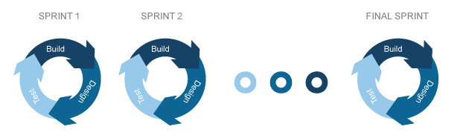
Sprints
Scrum projects make progress in a series of “sprints”
Typical duration is 2–4 weeks or a calendar month at most
A constant duration leads to a better rhythm
Product is designed, coded, and tested during the sprint
No Changes during Sprints

Slide 24
Sprint Planning Meeting
Team capacity
Analyze and evaluate product backlog
Select sprint goal
Sprint prioritization
Product backlog
Sprint goal
Business Condition
Sprint planning
Decide how to achieve sprint goal (design)
Create sprint backlog (tasks) from product backlog items (user stories / features)
Estimate sprint backlog in hours
Sprint backlog
Current Product
Technology

Slide 25
Sprint Planning Agenda
Team selects items from the product backlog they can commit to completing
Sprint backlog is created
Tasks are identified and each is estimated (1-16 hours)
Collaboratively, not done alone by the ScrumMaster
High-level design is considered
Code the middle tier (8 hours)
Code the user interface (4)
Write test fixtures (4)
Code the foo class (6)
Update performance tests (4)

Slide 26
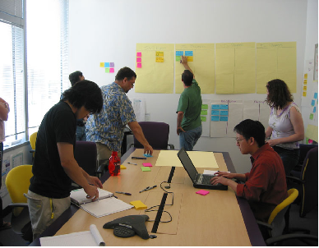
Daily Scrum
Parameters
Daily
15-minutes
Stand-up
Not for problem solving
Whole world is invited
Only team members, ScrumMaster, Product Owner can talk
Helps avoid other unnecessary meetings

Slide 27
Everyone answers 3 questions
What I did yesterday?
1
What I will do today?
2
Is Anything stopping me
3
These are not status for the ScrumMaster
They are commitments in front of peers

Slide 28
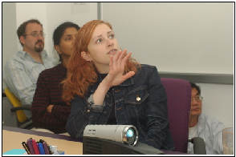
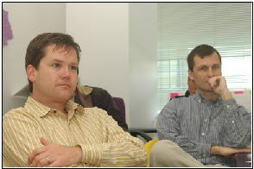
Sprint review
Team presents what it accomplished during the sprint
Typically takes the form of a demo of new features or underlying architecture
Informal
2-hour prep time rule
No slides
Whole team participates
Invite the world

Slide 29
Sprint retrospective
Periodically take a look at what is and is not working
Typically 15–30 minutes
Done after every sprint
Whole team participates
ScrumMaster
Product owner
Team
Possibly customers and others

Slide 30
Scrum Framework
Roles
Product Owner
Scrum Master
Team
Ceremonies
Sprint Planning
Sprint Review
Sprint Retrospective
Daily Scrum
Artifacts
Product Backlog
Sprint Backlog
Burndown Charts

Slide 31
Start / Stop / Continue
Whole team gathers and discusses what they’d like to:
Continue doing - What went Well
Stop doing – What went wrong
This is just one of many ways to do a sprint retrospective.
Start doing - What to improve

Slide 32
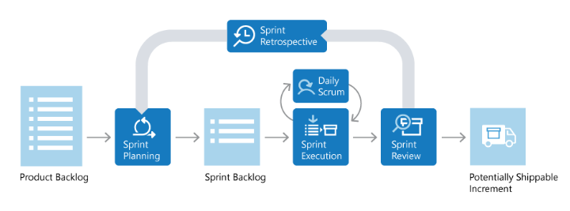
Product backlog
The requirements
A list of all desired work on the project
Ideally expressed such that each item has value to the users or customers of the product
Prioritized by the product owner
Reprioritized at the start of each sprint

Slide 33
User Stories
Instead of Use Cases, Agile project owners do "user stories"
Who (user role) – Is this a customer, employee, admin, etc.?
What (goal) – What functionality must be achieved/developed?
Why (reason) – Why does user want to accomplish this goal?
As a [user role], I want to [goal], so I can [reason].
Example:
"As a user, I want to log in, so I can access subscriber content."
story points: Rating of effort needed to implement this story
common scales: 1-10, shirt sizes (XS, S, M, L, XL), etc.

Slide 34
A sample product backlog
Backlog Item | Estimate
Allow a guest to make a reservation | 3
As a guest, I want to cancel a reservation. | 5
As a guest, I want to change the dates of a reservation. | 8
As a hotel employee, I can run RevPAR reports (revenue-per-available-room) | 1
Improve exception handling | 2
… | 13
… | 3

Slide 35
The sprint goal
A short statement of what the work will be focused on during the sprint
Application
Support features necessary
for marksheet.
Database
Make the application run on SQL Server in addition to Oracle.
Make the application calculate fees based on optional selected by student
Financial

Slide 36
Managing the sprint backlog
Individuals sign up for work of their own choosing
Work is never assigned
Estimated work remaining is updated daily
Any team member can add, delete or change the sprint backlog
To be approved by Product Owner
Work for the sprint emerges
If work is unclear, define a sprint backlog item with a larger amount of time and break it down later
Update work remaining as more becomes known

Slide 37
Sprint Backlog
Individuals sign up for work of their own choosing
Work is never assigned
Estimated work remaining is updated daily
Any team member can add, delete change sprint backlog
Work for the sprint emerges
If work is unclear, define a sprint backlog item with a larger amount of time and break it down later
Update work remaining as more becomes known

Slide 38
Sample Sprint backlog
Tasks
Mon
Tue
Wed
Thu
Fri
Code the user interface
8
4
8
Code the middle tier
16
12
10
4
Test the middle tier
8
16
16
11
8
Write online help
12
Write the Foo class
8
8
8
8
8
Add error logging
8
4
Notes:
‹#›

Slide 39
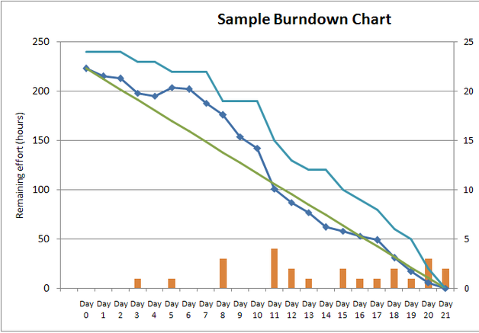
Sprint Burndown Chart
A display of what work has been completed and what is left to complete
one for each developer or work item
updated every day
(make best guess about hours/points completed each day)
variation: Release burndown chart
shows overall progress
updated at end of each sprint

Slide 40
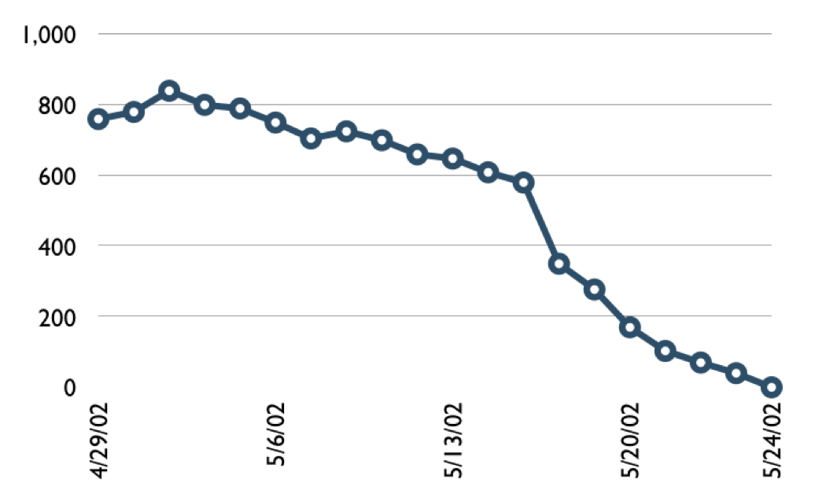

Sample Burndown Chart
Hours
Notes:
‹#›

Slide 41
Tasks
Mon
Tue
Wed
Thu
Fri
Code the user interface
8
4
8
Code the middle tier
16
12
10
7
Test the middle tier
8
16
16
11
8
Write online help
12
150
Hours
0
Mon
Tue
Wed
Thu
Fri
Notes:
‹#›

Slide 42
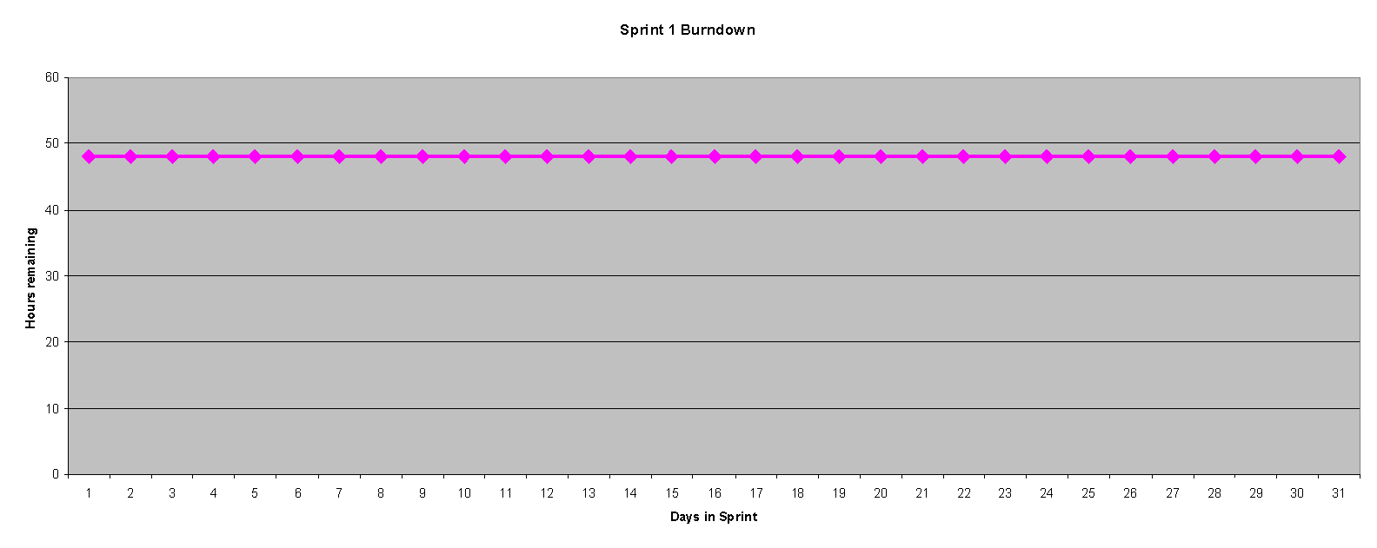
Burndown Example 1
No work being performed

Slide 43
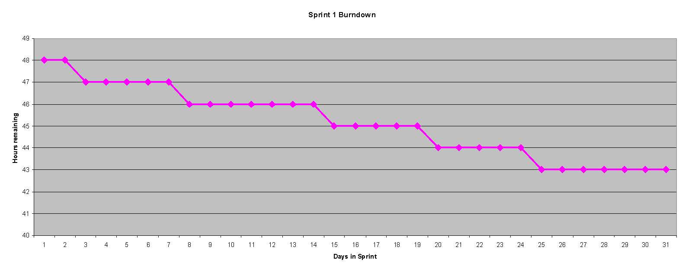
Burndown Example 2
Work being performed, but not fast enough

Slide 44
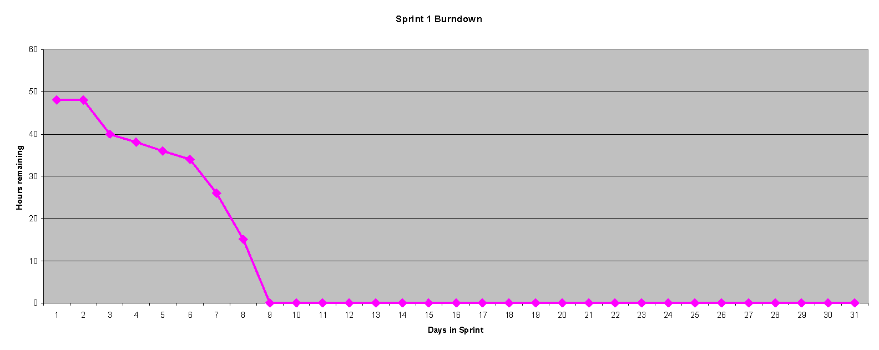
Burndown Example 3
Work being performed, but too fast!

Slide 45

A sprint burndown chart
50
40
30
20
Hours
10
0
Mon
Tue
Wed
Thu
Fri

Slide 46
Scrum in 100 Words
Scrum is an agile process that allows us to focus on delivering the highest business value in the shortest time.
It allows us to rapidly and repeatedly inspect actual working software (every two weeks to one month).
The business sets the priorities. Teams self-organize to determine the best way to deliver the highest priority features.
Every two weeks to a month anyone can see real working software and decide to release it as is or continue to enhance it for another sprint.

Slide 47
Scrum Characteristics
Self-organizing teams
Product progresses in a series of month-long “sprints”
Requirements are captured as items in a list of “product backlog”
No specific engineering practices prescribed
Uses generative rules to create an agile environment for delivering projects
It is one of the “agile processes”

Slide 48
Kanban
In Japanese the word Kan means "signal" and "ban“ means "card" or “board”.
A Kanban card is a signal that is supposed to trigger action.
Therefore Kanban refers to "signal cards". You can see Kanban everywhere.

Slide 49
Kanban Principles
The basic principles of Kanban for software engineering
Limit Work in Process (WIP)
Pull value through (with WIP limit)
Make it visible (Visual Control)
Increase throughput
Fixed Kanban Backlog
Quality is embedded in (not inspected in)
The team continuously monitor the above to improve

Slide 50
Why Pull? Why Kanban?
We:
Don’t build features that nobody needs right now
Don’t write more specs than you can code
Don’t write more code than you can test
Don’t test more code than you can deploy

Slide 51
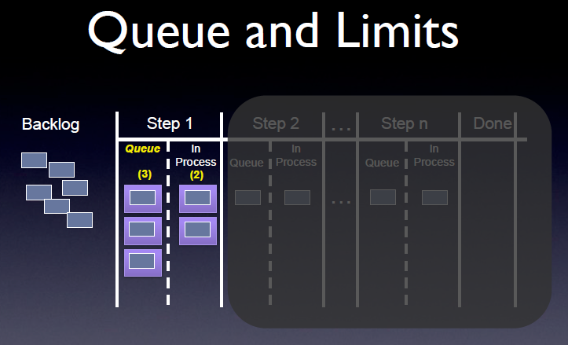

Slide 52
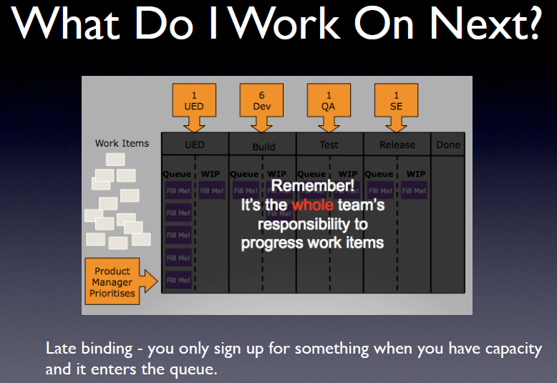

Slide 53
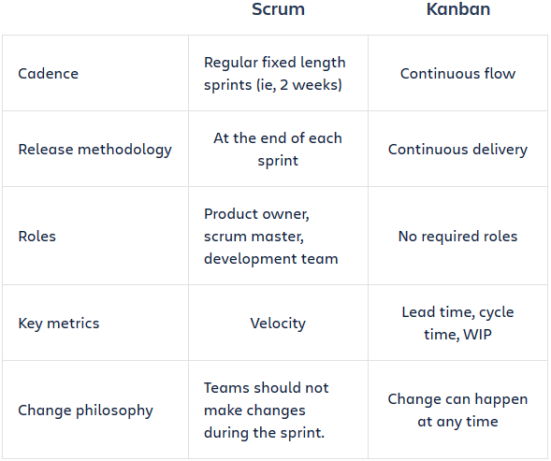
Scrum v/s Kanban

Slide 54
Scrumban
Teamwork is organized in small iterations and monitored with the help of a visual board
Planning meetings are held to determine what user stories to complete in the next iteration
To keep iterations short, WIP limits are thus used, and a planning trigger is set in place for the team to know when to plan next - when WIP falls below a predetermined level
There are no predefined roles in Scrumban; the team keeps the roles they already have

Slide 55
Scrumban Keywords...
Iterations - Work iterations in Scrumban are kept short. This ensures that a team can easily adapt and change their course of action to a quickly changing environment.
On-demand planning - The planning in Scrumban is based on demand and occurs only when the planning trigger goes off. The planning trigger is associated with the number of tasks left in the "To Do" section of the board - when it goes down to a certain number, the planning event is held
Prioritization - It is recommended to prioritize tasks during the planning event. This means the tasks are added to the board with marked priorities.
Bucket size planning - Bucket size planning brings the possibility of long-term planning to Scrumban. It is based on the system of three buckets that the work items need to go through before making it on the Scrumban board
Notes:
Bucket size planning brings the possibility of long-term planning to Scrumban. It is based on the system of three buckets that the work items need to go through before making it on the Scrumban board. The three buckets represent three different stages of the plan and are usually called 1-year, 6-month and 3-month buckets. The 1-year bucket is dedicated for long-term goals that the company has, like penetrating a new market, releasing new product, etc. When the company decides to move forward with a plan, it is moved to the 6-month bucket, where the main requirements of this plan are crystallized. When a company is ready to start implementing the plan, the requirements are moved into the 3-month bucket and divided into clear tasks to be completed by the project team. It is from this bucket that the team draws tasks during their on demand planning meeting and starts working on the tasks

Slide 56
Scrumban Keywords...
Lead and cycle time the time that is taken from task creation or beginning work on a task to its completion.
The Board - The basic Scrumban board is composed out of three columns: To Do, Doing and Done.
WIP limits -- To ensure that the team is working effectively, Scrumban methodology states that a team member should be working on no more than one task at a time. To make sure this rule is followed Scrumban uses WIP (work in progress) limit.
To Do limits -- In order to have more productive planning meetings the number of tasks in the To Do section can be limited as well.
Pull principle - In Scrumban tasks are not assigned to the team members by the team leader or project manager. Each team member chooses which task from the To Do section they are going to complete next.

Slide 57
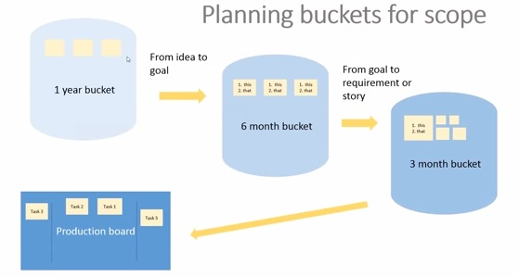
Scrumban Buckets

Slide 58
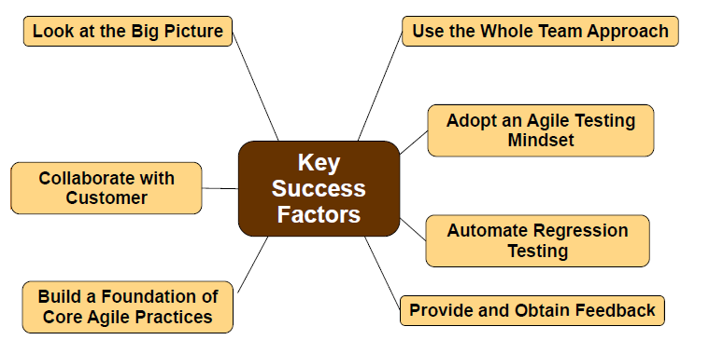
Key Success Factors

Slide 59
Questions ?
Thank You

Slide 60
Where to go next
www.mountaingoatsoftware.com/scrum
www.scrumalliance.org
www.controlchaos.com
www.agileatlas.org

